Slide 1

TRANSACTION SYSTEM WEBSITE by Churchil Yash Rajpal

Slide 2

NEED OF ONLINE BANKING
Online Banking is not a new term, in-fact it was the need of the time as more and more customers and their data was increasing, handling it manually was becoming a very tedious task for the bank. Thus came the solution to shift the whole process on the internet and access them either
through a website or an app.
Our modal applies this
banking process through website.

Slide 3
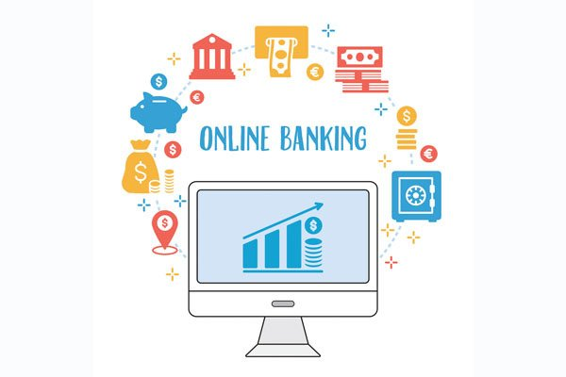
ADVANTAGES OF ONLINE BANKING
A user consuming this facility can conduct financial related tasks.
Safe and secure mode of banking.
Customers can apply for the issuance of the passbook.
Update/Change their login
credentials and PIN details.
24/7 availability.

Slide 4

GOALS OF THE PROJECT
A robust and effective web based online banking system.
Personal banking services that gives you complete control over all your banking demands online
Simple and easy user interface to work with.
Customer’s Satisfaction
Saving Time, and
Security of the data.

Slide 5

SECURITY FEATURES OF THE PROJECT
Each and every input is passed through mysqli_real_escape_string() to remove any special characters from the string so that user can’t submit arbitrary input:
$uname = mysqli_real_escape_string($conn, $_POST["cust_uname"]);
$pwd = mysqli_real_escape_string($conn, $_POST["cust_psw"]);
$sql0 = "SELECT * FROM customer WHERE uname='".$uname."' AND pwd='".$pwd.“’”;
$result = $conn->query($sql0);
$row = $result->fetch_assoc();

Slide 6

SECURITY FEATURES OF THE PROJECT (cont.)
Before any page of the customer/admin part is displayed a check is made to ensure that the customer/admin session is valid and active.
if (($result->num_rows) > 0) {
$_SESSION['loggedIn_cust_id'] = $row["cust_id"]; $_SESSION['isCustValid'] = true; $_SESSION['LAST_ACTIVITY'] = time(); header("location:customer_home.php");
}

Slide 7

SECURITY FEATURES OF THE PROJECT (cont.)
Finally, sensitive details like password/username in a form are passed through method = “POST” and not method = “GET” to prevent leak of such data via the URL.

Slide 8
OVERVIEW OF WEBSITE FEATURES For Admin
Admin can access the website using his credentials.
if (isset($_GET['loginFailed'])) {
$message = "Invalid Credentials ! Please try again."; echo "<script type= 'text/javascript'>alert('$message');</script>";
}
Admin can add, edit or delete the customer.
Admin can also view the Transaction History of every customer.
There is no account for admin in the bank.

Slide 9

OVERVIEW OF WEBSITE FEATURES For Customers
Customers can login into website using the credentials given by the bank.
Customers can check the passbook related with their account and also can sort it with date and transaction number.
Customer can also add a beneficiary and transfer amount to him/her
Customer can delete a beneficiary.
Customer can debit/credit
money into his/her
account using an ATM
simulator

Slide 10
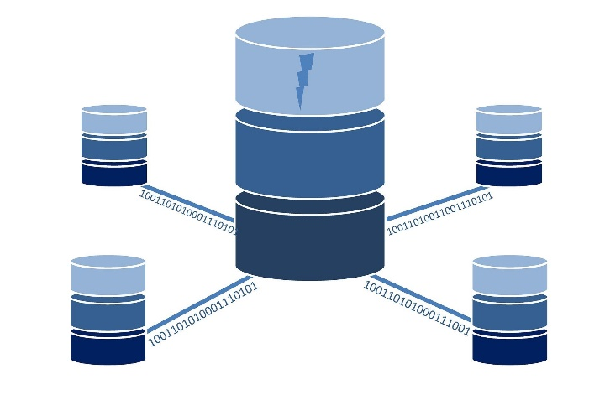
DATABASE
The database contains customer & admin tables.
Each customer has its own virtual passbook table linked with his/her account number.
Each customer has its own beneficiary table linked with his/her account number.
Admin only has the right of managing customers and providing passbooks, username and password updates for them.

Slide 11
CONCLUSION AND FUTURE SCOPE
The “Transaction System Website” is a modern project and I am grateful to have been given this wonderful opportunity to work on a banking online system.
The most important future perspectives is, more bank branches, maybe global, which means more ATM machines outside. Customer issues will be created based on their requirements, ensuring that the help desk is aware of their requirements and simple to use.

Slide 12

Thank you

